Slide 1

Data Science Presentation
Topic - Logistic Regression
Mohammad Shaharyar Ansari
M.Tech-CSE Sem- 2
2208580675008

Slide 2
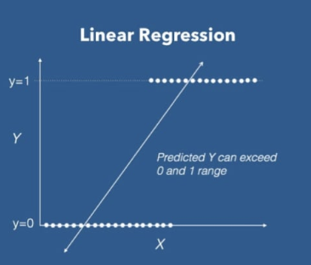
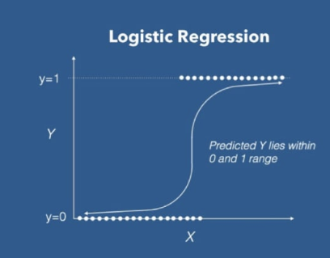
Logistic Regression
It is a Supervised Machine Learning Algorithm
It is a Classification Algorithm.
Generally used for Binary Classification e.g. “YES” and “NO”, or “0” and “1”.
When the data is categorical we use logistic regression instead of linear regression.
Takes input from linear regression function and output the probability that an instance belong to a given class or not.
Output of logistic regression depends on Sigmoid Function.

Slide 3
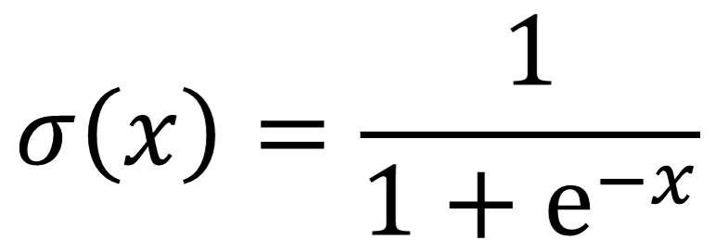
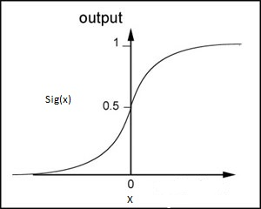
Sigmoid Function
A sigmoid function is a mathematical function having a characteristic "S"-shaped curve or sigmoid curve.
Input Range = [-∞ to ∞]
Output Range = [0,1]

Slide 4
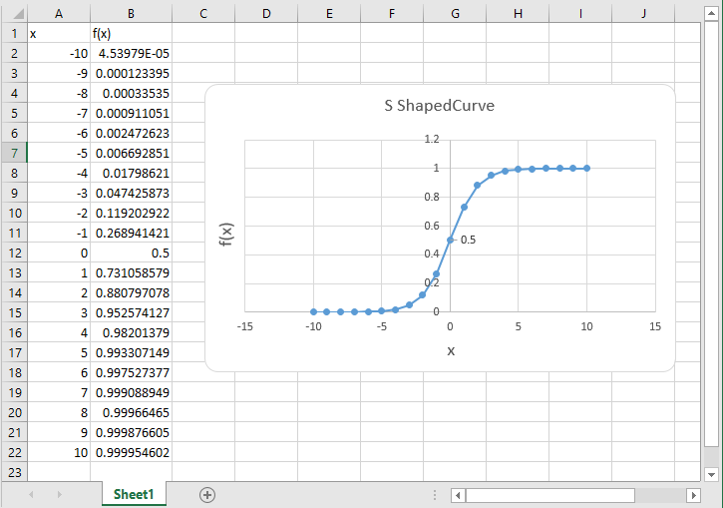
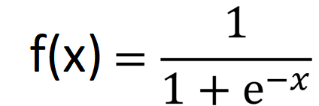
S Shaped Curve

Slide 5
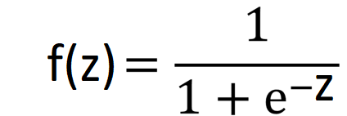
Model
The logistic function is of the form,
Where z is the linear function given by,
z = W^{T} X+ b
Output of logistic regression mode,
{
ŷ =
0 , f(z) < 0.5
1 , f(z) >= 0.5

Slide 6
Application
Spam or not spam
Disease Diagnosis
Fraud detection

Slide 7
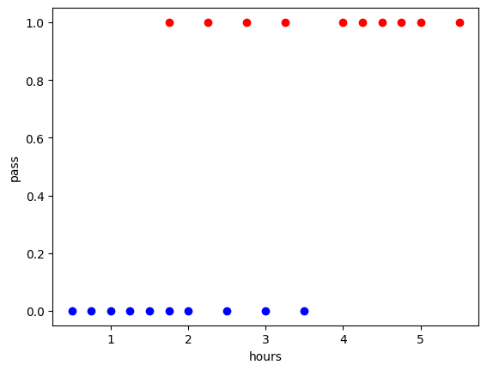
Example
hours | 0.5 | 0.75 | 1 | 1.25 | 1.5 | 1.75 | 1.75 | 2 | 2.25 | 2.5 | 2.75 | 3 | 3.25 | 3.5 | 4 | 4.25 | 4.5 | 4.75 | 5 | 5.5
pass | 0 | 0 | 0 | 0 | 0 | 0 | 1 | 0 | 1 | 0 | 1 | 0 | 1 | 0 | 1 | 1 | 1 | 1 | 1 | 1
1
0

Slide 8
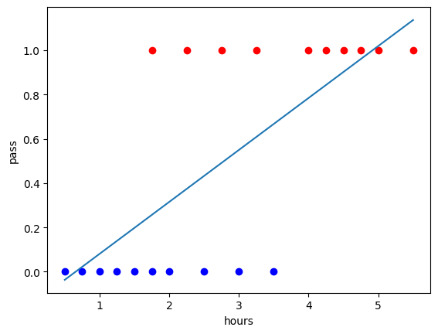
Example(contd..)
After applying linear regression,
Y = 0.2346*X - 0.1539
1
0

Slide 9
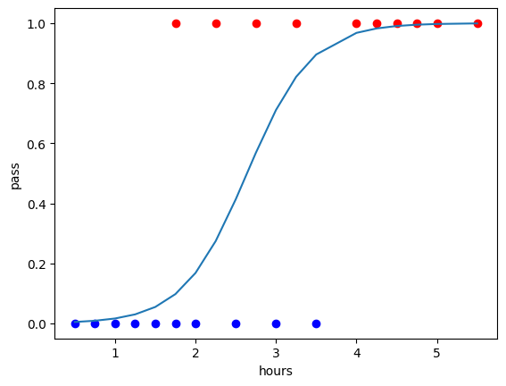
Example(contd..)
Applying Logistic regression
When w = 2.5 and b = 6.6
z = 2.5x + 6.6
1
0

Slide 10
Thank You!

